Slide 1
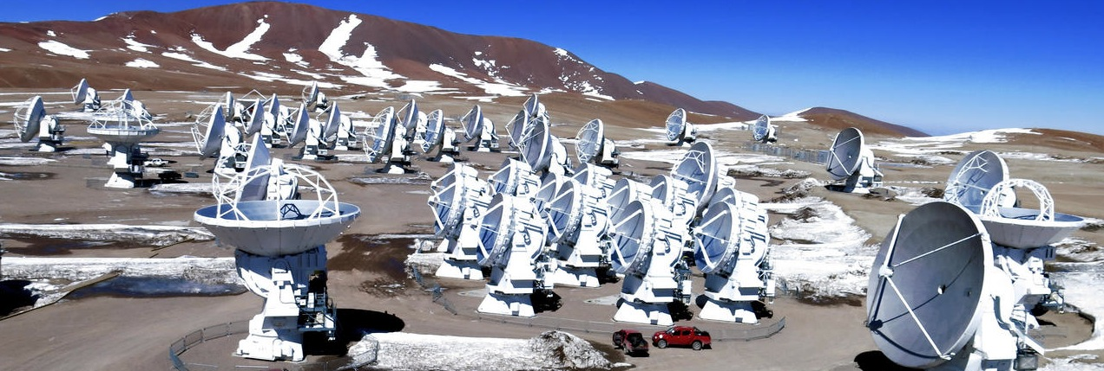
An Introduction to the Cycle 11 ALMA Observing Tool
Jackie Champagne, adapted from Fengwu Sun
Steward Observatory, University of Arizona
EURECA March 29, 2024
Atacama Large Millimeter/submillimeter Array
Expanded Very Large Array
Very Long Baseline Array

Slide 2

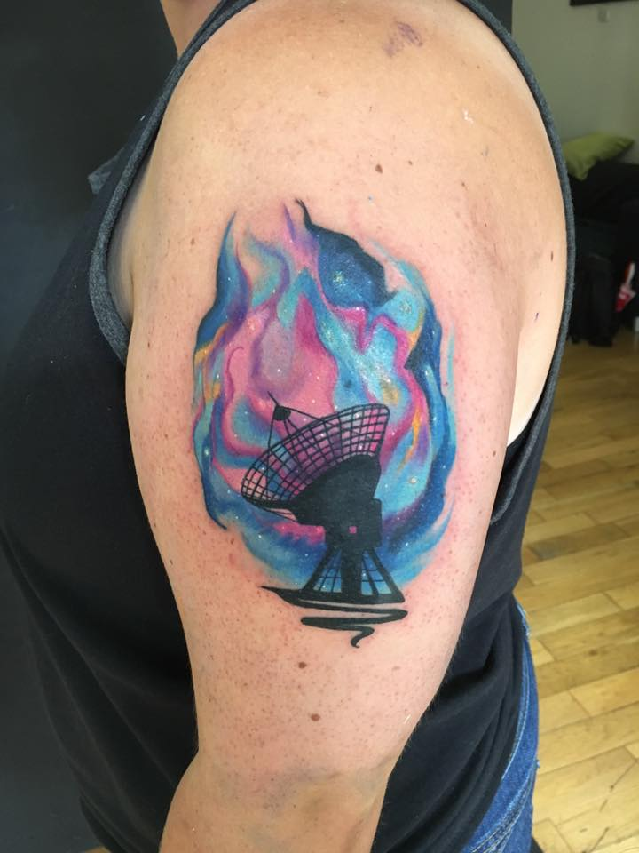
Why should you listen to Jackie?
Because she is #GirlwiththeALMATattoo.

Slide 3
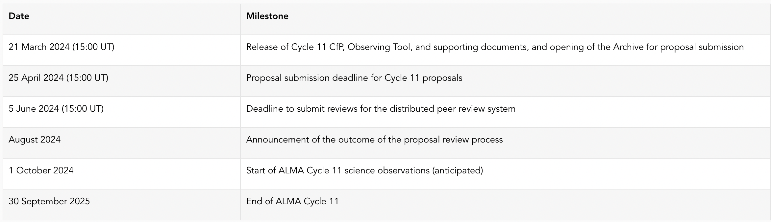
ALMA Cycle 11 Planning https://almascience.nrao.edu/proposing/call-for-proposals
ALMA Cycle 11 will start in October 2024 and will span 12 months. The JAO anticipates having 4300 hours for approved science observations on the 12-m Array and 4300 hours on the Atacama Compact Array (ACA), also known as the Morita Array. Projects with observations in the highest-frequency Bands 8, 9, and 10 are strongly encouraged.
As in Cycle 10, PI will no longer make small changes &
re-submit projects in early summer
Changes to accepted projects will be made via the helpdesk

Slide 4
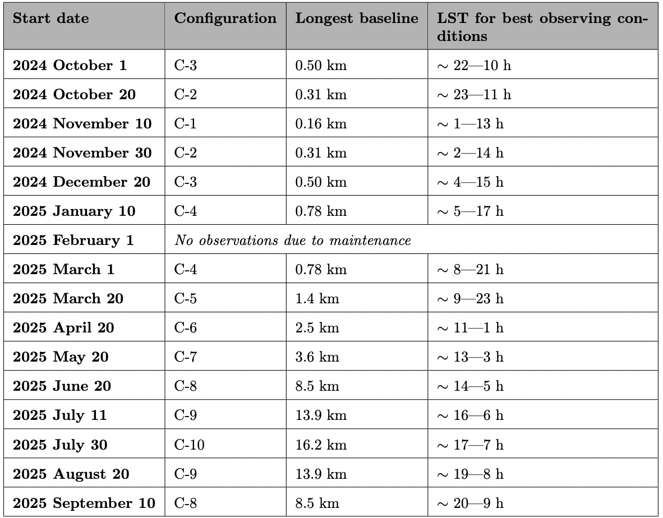
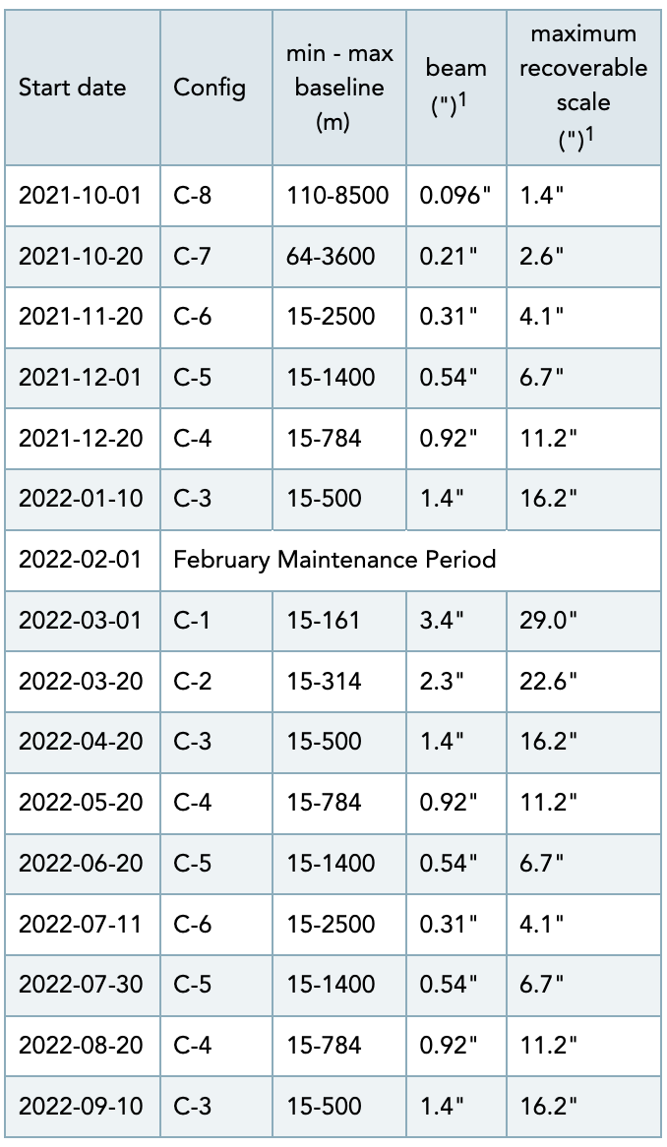
Configurations
The configuration schedule strongly influences when an object will be observed
Some combinations of object RA and desired angular resolution may not allow night observing
λ3mm
λ3mm

Slide 5
Cycle 11 Capabilities - I
Antennas: 43+ in the 12-m Array; ten 7-m antennas; three 12-m total power, spectral line antennas in the ACA
Receiver bands: 3, 4, 5, 6, 7, 8, 9, 10
(wavelengths 3.1, 2.1, 1.5, 1.3, 0.87, 0.74, 0.44, 0.35 mm)
Maximum baselines/largest 12m array configurations:
16.2 km (bands 3–8), 13.9 km (band 3-9), 8.5 km (band 3-10)
C43-10 (bands 3-8), C43-9 (band 3-9), C43-8 (band 3-10)
Spectral line, continuum, and mosaic observations:
Spectral line and continuum observations with the 12-m and 7-m Arrays in all bands
Single field interferometry (all bands) and mosaics (Bands 3 - 9) with both the 12-m and 7-m arrays
Single dish (total power) spectral line in Bands 3 - 8

Slide 6
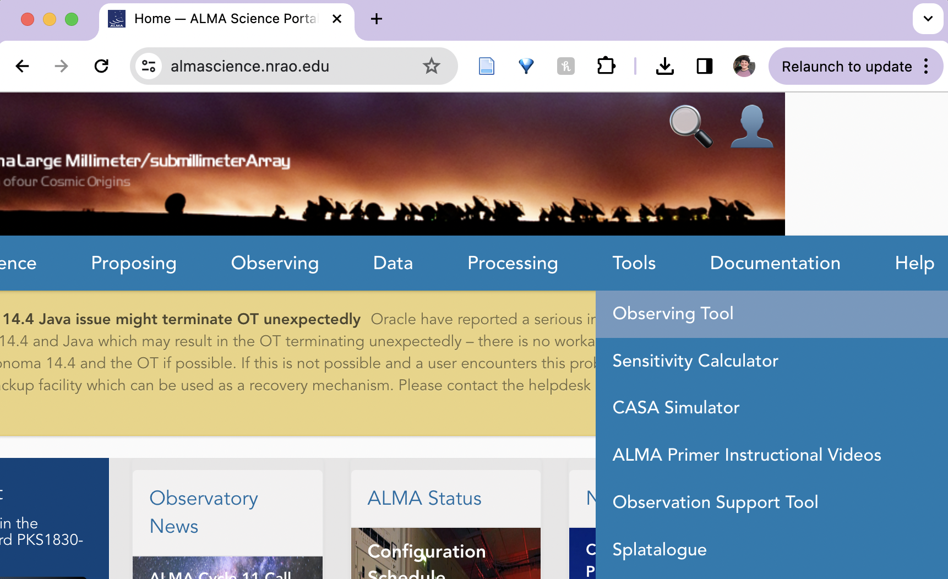
Where is the OT?
On the science portal under Proposing, click on Observing Tool
Notes:
I recommend webstart cuz you know you’re up to date

Slide 7
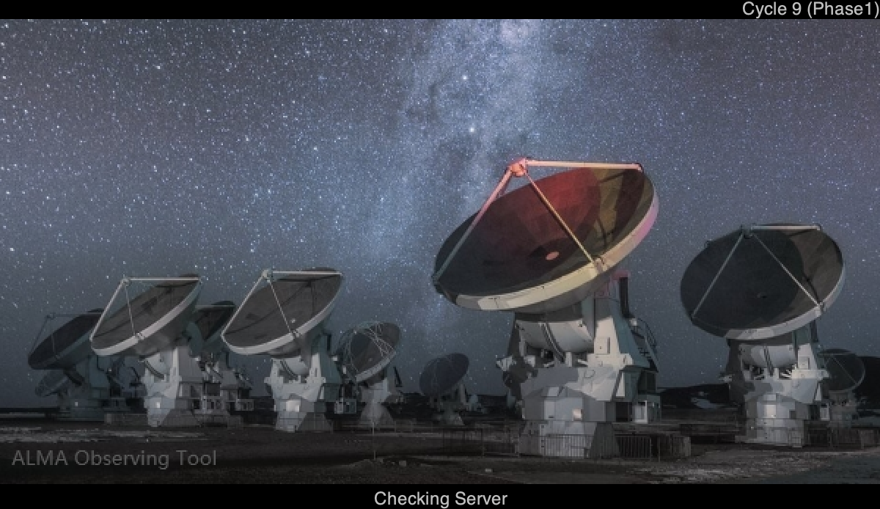
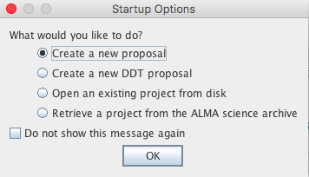
When the ALMA OT starts
PI: Make sure to use the Cycle 11 OT from the Science Portal
**I recommend uninstalling previous versions first**
First you see this
Then you see this
Notes:
I recommend webstart cuz you know you’re up to date

Slide 8
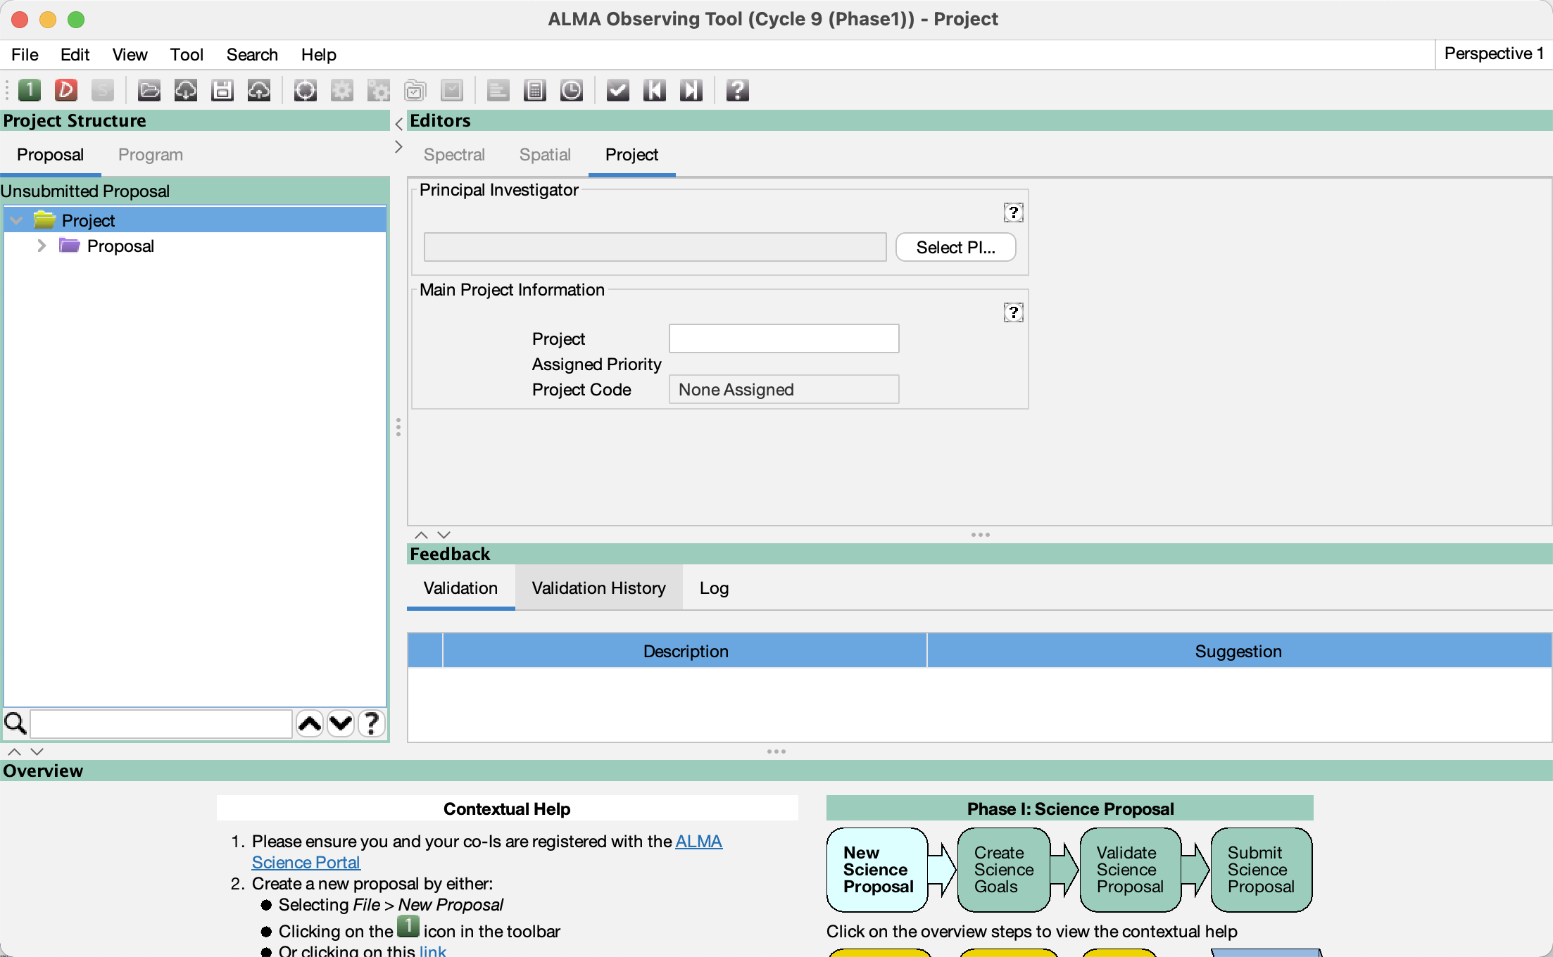
The Project node in the J-tree
A clean slate. From here, you can:
Start a new proposal
Add blank Science Goals (SG)
Recall a project from the archive
As new or to use as a template
Or look at it as-is
This is a J-tree ☺
Use the key icons to expand/contract nodes

Slide 9
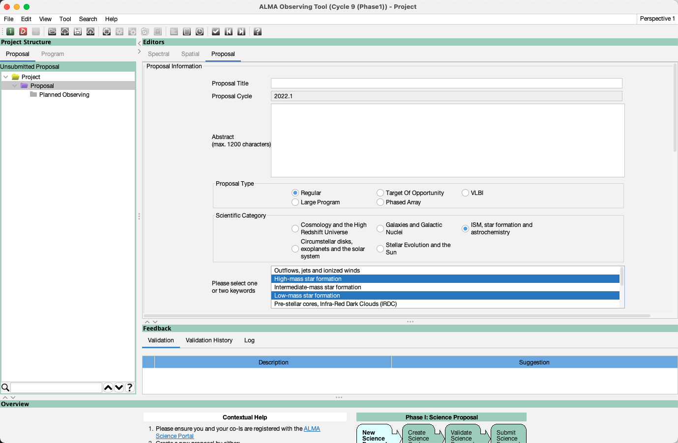
The Proposal node in the J-tree
This page has your meta information, proposal title, abstract, proposal type, scientific category (for the review panels)
This is the J-tree and the proposal node is where you provide a broad description
.P proposals in Receiver band 3
Keywords appear after proposal type is chosen
You can search the J-tree for names of nodes, details are in (?) help

Slide 10
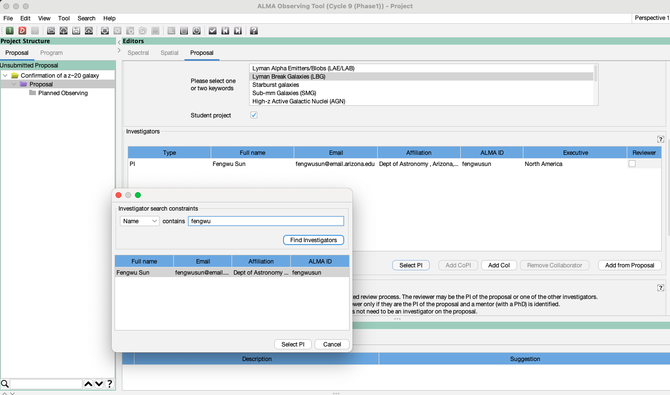
Proposal: pick PI, CoI & designate reviewer
Title
Select Keyword
For DPR. Can be a Co-I but someone must be indicated
Select PI/Co-I’s from registered ALMA users (only)

Slide 11
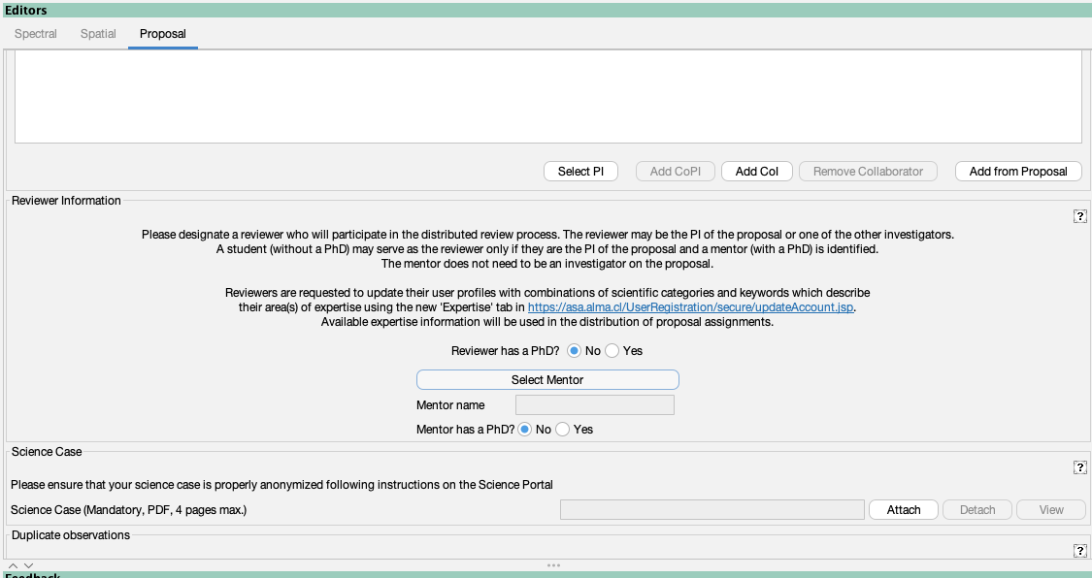
Scroll down, pick reviewer/mentor
pre-PhD PI chooses PhD Mentor
Mentor not needed if “yes”
Student PI picks PhD mentor
PhD status of mentor must be confirmed

Slide 12
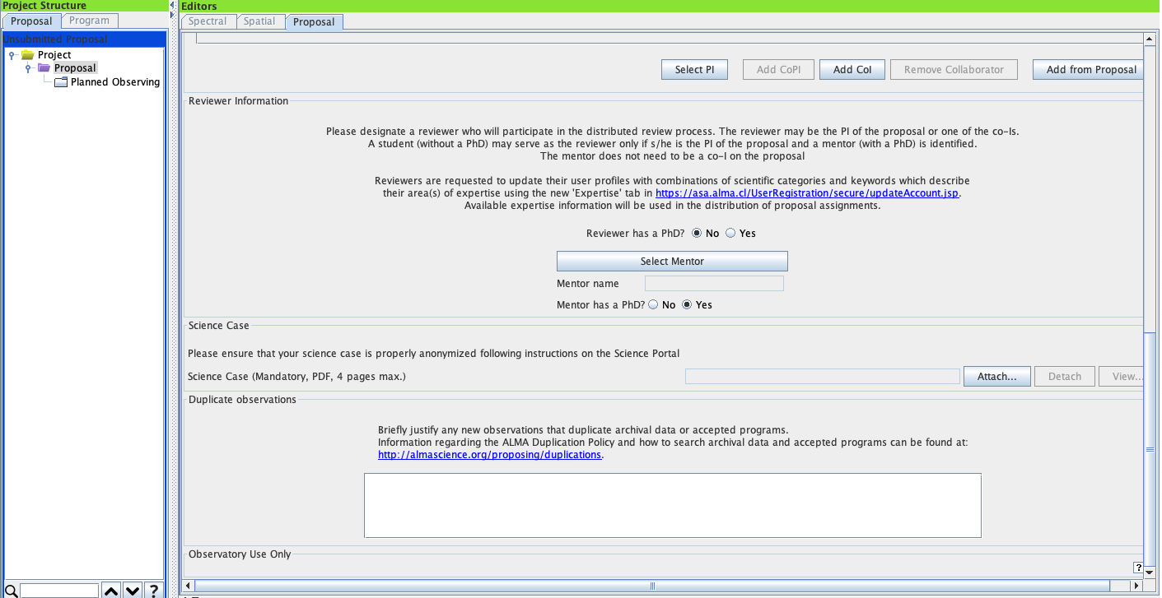
Attach the science case as a .pdf
New!
which is why you hide captions in a powerpoint figure and save as pdf! hehe
pre-PhD PI chooses PhD Mentor
Student PI picks PhD mentor
PI confirms status of mentor
Attach a science case, max 4 page .pdf including figures
The .pdf may not contain more than 15% of its text in a font below 12pt
Some .pdf creation software pads files with hidden text in small fonts
Large proposals are allowed 6 pages and require an additional one page management plan

Slide 13
Justify duplicative observing
Justification of duplication of observations
This replaces an earlier mechanism whereby project codes were given
Give a concise justification if asking to duplicate previous observations or accepted proposals. This is not used if resubmitting a rejected proposal

Slide 14
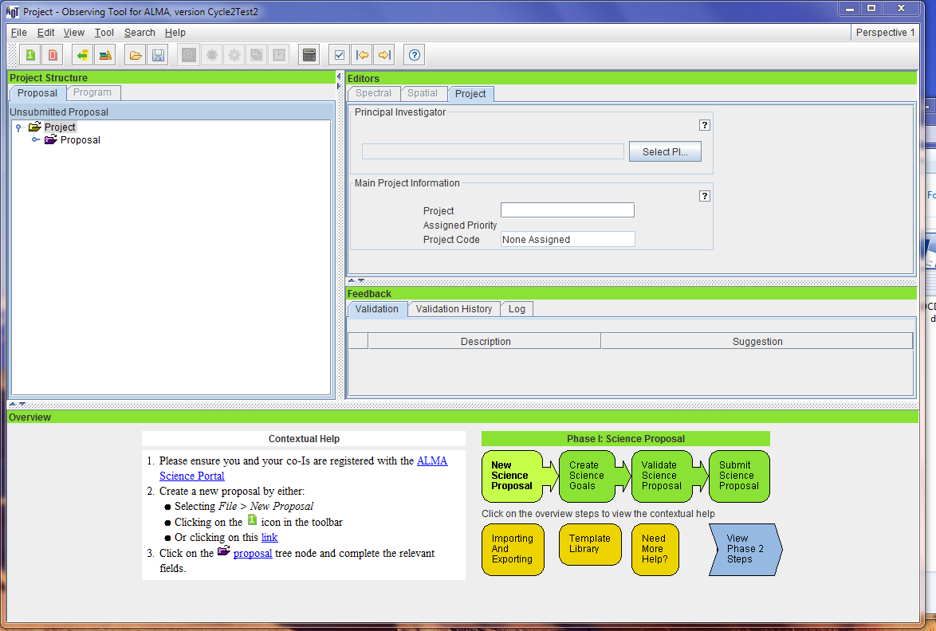
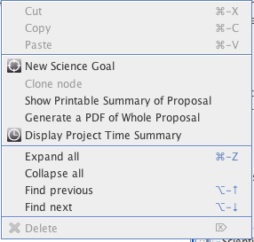
Do some science - add a Science Goal
You can clone science goals when you have them
You can right-click and add blank Science Goals or use options of the File menu as shown on the next slide)

Slide 15
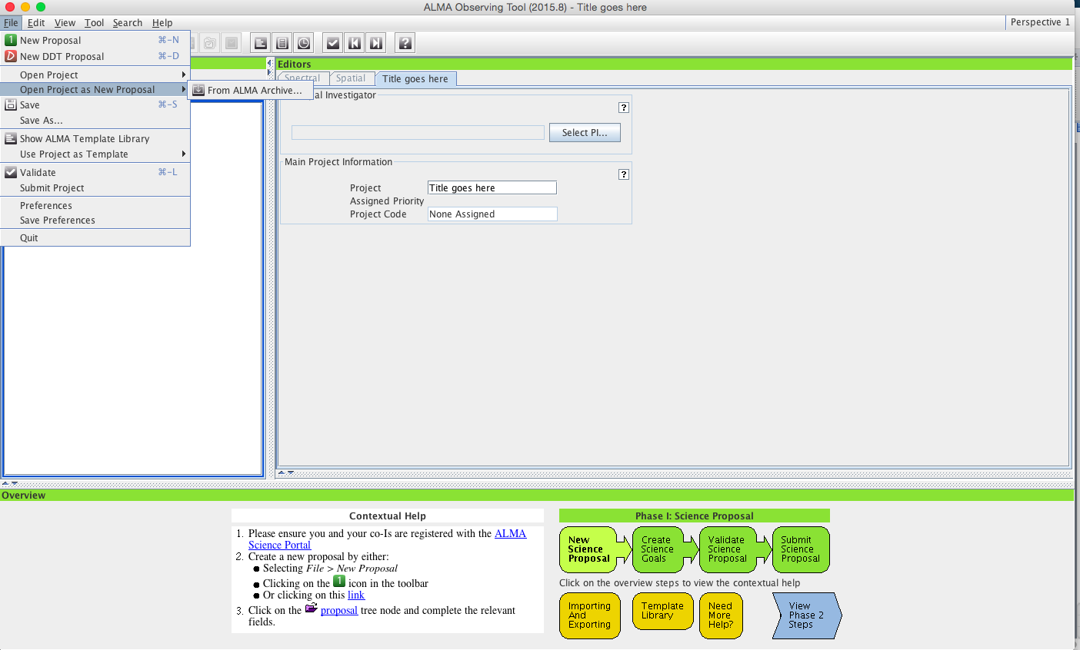
Since Cycle 4, a previously-submitted project
can be opened as a new one from the archive
Since Cycle 6, an old DDT proposal can be
opened from the archive as a new proposal
The alma template library is no longer included after so much experience with real observing
Click here to simultaneously access another project from disk or archive, which you can use to copy/paste nodes into a new project
Notes:
Note from Harvey: In previous cycles it was not possible to copy/paste text from within templates and this is still not working as of Groundhog Day

Slide 16
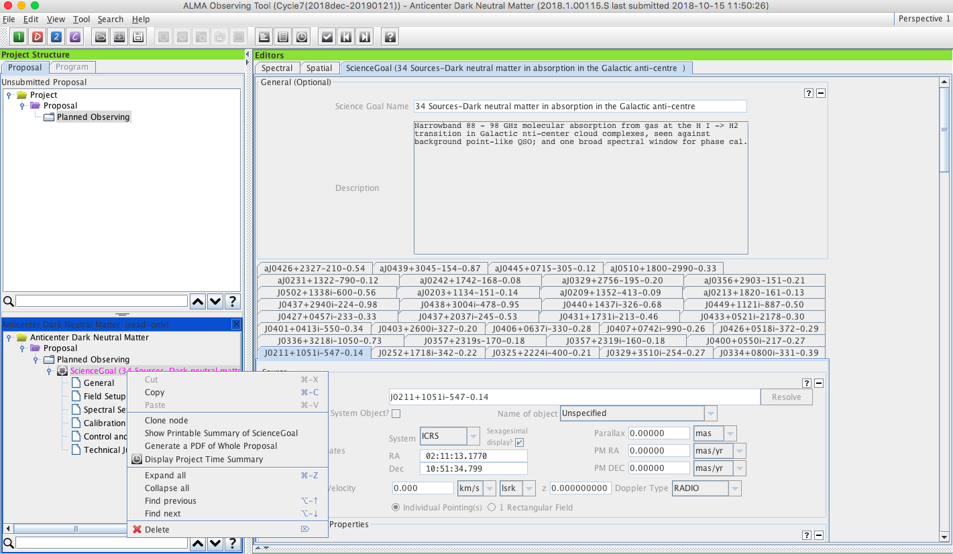
PROJECTS AS TEMPLATES
This science goal in the template can be copied whole into new Planned Observing.
Works with any node. Sub- nodes in target SG are over written when copy/pasting
Notes:
Note from Harvey: In previous cycles it was not possible to copy/paste text from within templates and this is still not working as of Groundhog Day

Slide 17
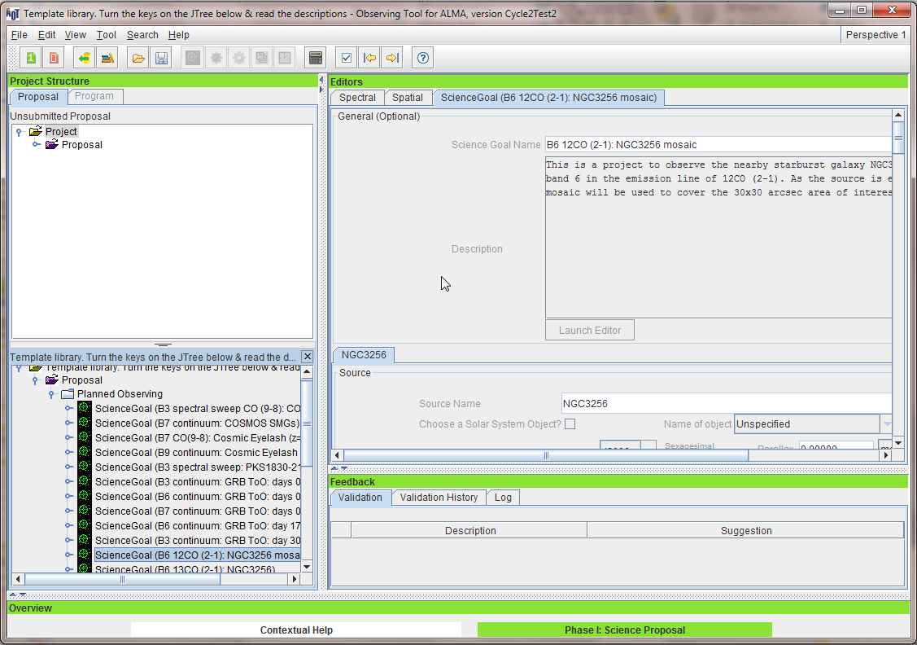
You’re now ready to flesh out the Science Goal (SG)
Give the SG a brief, descriptive name.
A description is useful for you, for the technical assessors, and for your Contact Scientist after your project is approved. But it’s optional

Slide 18
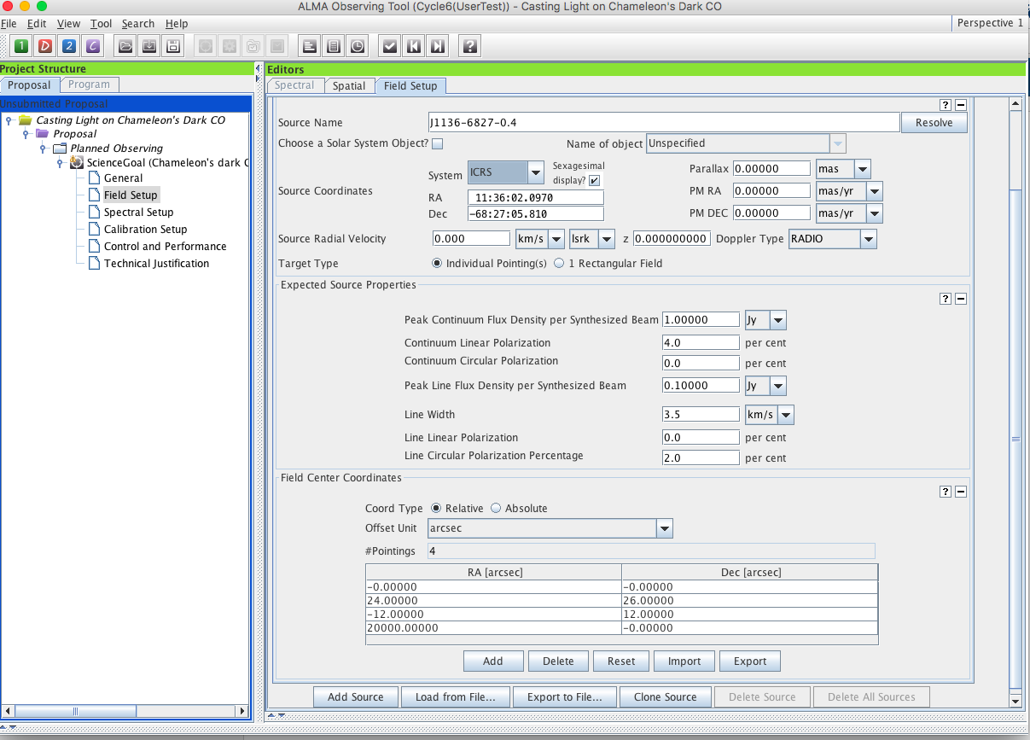
The field setup node is where you provide source coordinates and other basic properties for one or more field sources/pointings

Slide 19
New! And super-annoying! The OT will issue a validation warning whenever the velocity is left at the 0 km/s default. An archive issue.
The field setup node is where you provide source coordinates and other basic properties for one or more field sources/pointings

Slide 20
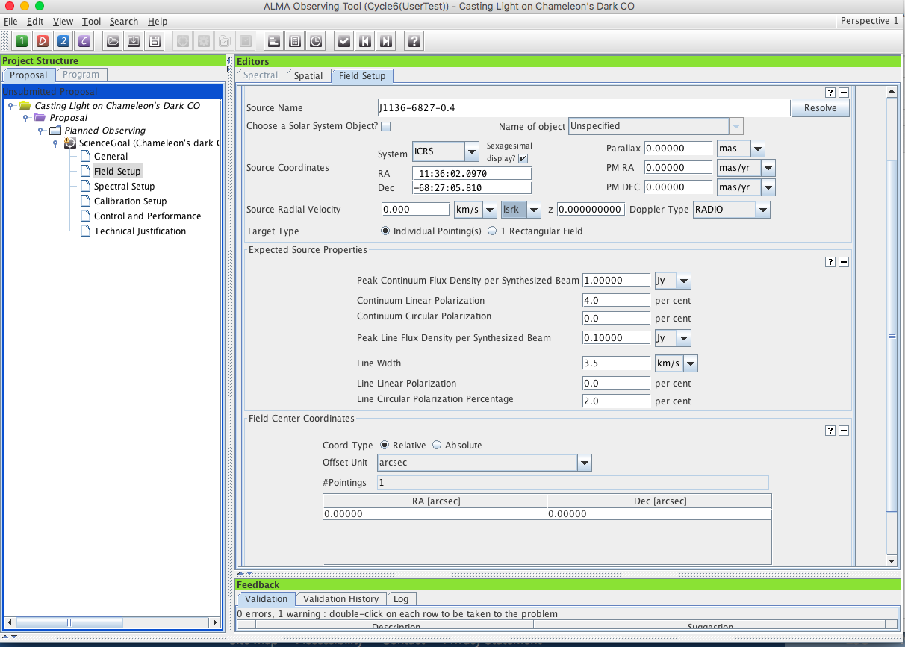
Since Cycle 4, OT defaults to ICRS, the standard radio coordinate system
Source name, position, proper motion, velocity, velocity rest frame. use “lsrk” for v_{LSR}
When you resolve a source name from the server, check all the returned info, some may be unwanted
Rectangular mosaic or 1/more offset pointings?
The expected source properties are used with the spectral setup, desired angular resolution, rms, to set the S/N, dynamic range and overall project viability
Expected polarization lower limits were made much simpler in Cycle 7: 0.1% for linear polarization and 1.8% for circular. These are now independent of correlator mode or source extent.

Slide 21
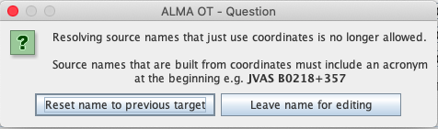
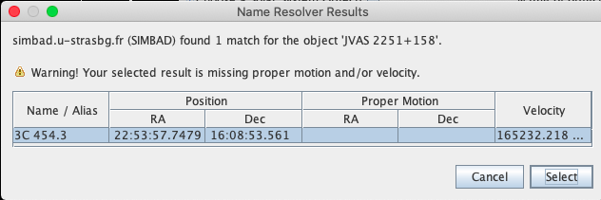
Since Cycle 4, OT defaults to ICRS, the standard radio coordinate system
Source name, position, proper motion, velocity, velocity rest frame. use “lsrk” for v_{LSR}
Hint: To resolve source names that are coordinates, preface with “JVAS” ie don’t use B2251+158, use
JVAS 2251+158
When you resolve a source name from the server, check all the returned info, some may be unwanted
Rectangular mosaic or 1/more offset pointings?
The expected source properties are used with the spectral setup, desired angular resolution, rms, to set the S/N, dynamic range and overall project viability
Expected polarization lower limits were made much simpler in Cycle 7: 0.1% for linear polarization and 1.8% for circular. These are now independent of correlator mode or source extent.

Slide 22
Since Cycle 4, OT defaults to ICRS, the standard radio coordinate system
Source name, position, proper motion, velocity, velocity rest frame. use “lsrk” for v_{LSR}
When you resolve a source name from the server, check all the returned info, some may be junk
Rectangular mosaic or 1/more offset pointings?
Only give polarization percentage for the polarization kind you wish to observe. The OT and pipeline key on the percentages to choose which is the goal of the project and the sensitivities and pointing possibilities of linear and circular are not the same
The expected source properties are used with the spectral setup, desired angular resolution, rms, to set the S/N, dynamic range and overall project viability

Slide 23
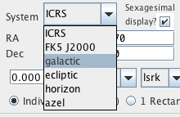
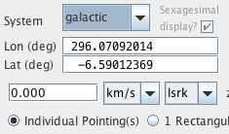
When you toggle the coordinate system between ICRS and Galactic the OT will convert between them
When using the spatial visualizer, the OT will find the correct image center for a position specified in galactic coordinates, but images returned by the standard image query servers are always in ICRS
Since Cycle 4, OT defaults to ICRS, the standard radio coordinate system
Source name, position, proper motion, velocity, velocity rest fame.
LSR gone, use LSRK
When you resolve a source name, check all the returned info: velocity, proper motions etc may be bogus
Rectangular mosaic or 1/more offset pointings?
The expected source properties are used with the spectral setup, desired angular resolution, rms, to set the S/N, dynamic range and overall project viability
Circular polarization is new! Smallest detectable circular pol. fraction is 1.8% for line or continuum

Slide 24
Individual pointings around a single target must overlap another pointing at the edges of their HPBW and all must be within 5º of the source coordinate
Pointings can be given as offsets or absolute sky positions, the
OT will convert between those if you check/uncheck Coord Type
Read/write a text file
See help for format or write a file
Read/write field sources to/from text files.
Format is described in help for ‘field source’ or write one out and examine it
Illegal!

Slide 25
Pointings must overlap another pointing at the edges of their HPBW and all must be within 5º of the source coordinate
Pointings can be given as offsets or absolute sky positions, the
OT will convert between those if you check/uncheck Coord Type
Read/write a text file
See help for format
File Input in galactic coordinates has been possible since Cycle 6!
l,b input in decimal degrees is assumed if coordinate entries have no colons! A hack.
Illegal!

Slide 26
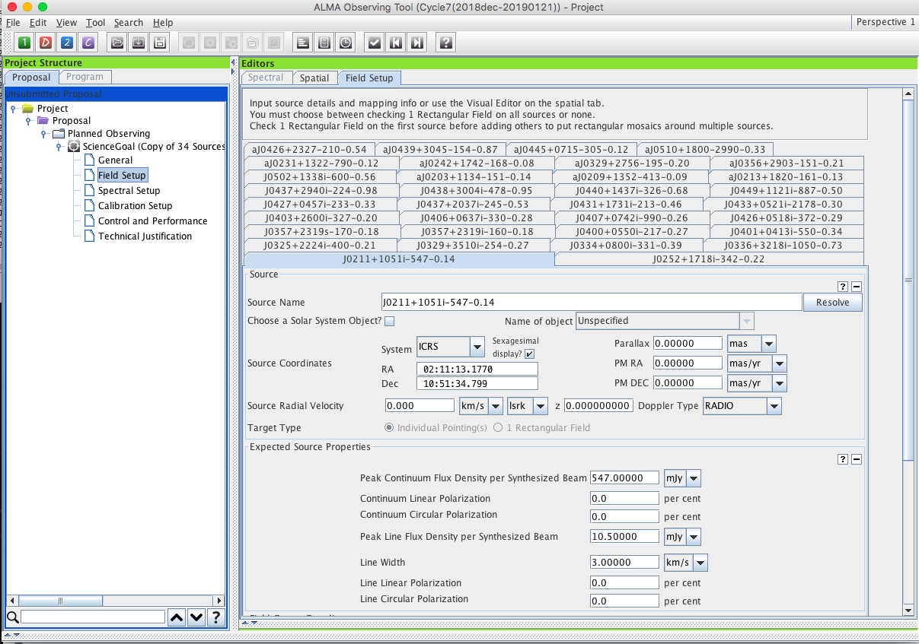
Sources having a common spectral setup, observing pattern (single pointings or rectangular mosaic), rms … can ^{(if possible, should!)} be put in the same Science Goal no matter how far apart they are, let the OT cluster them

Slide 27
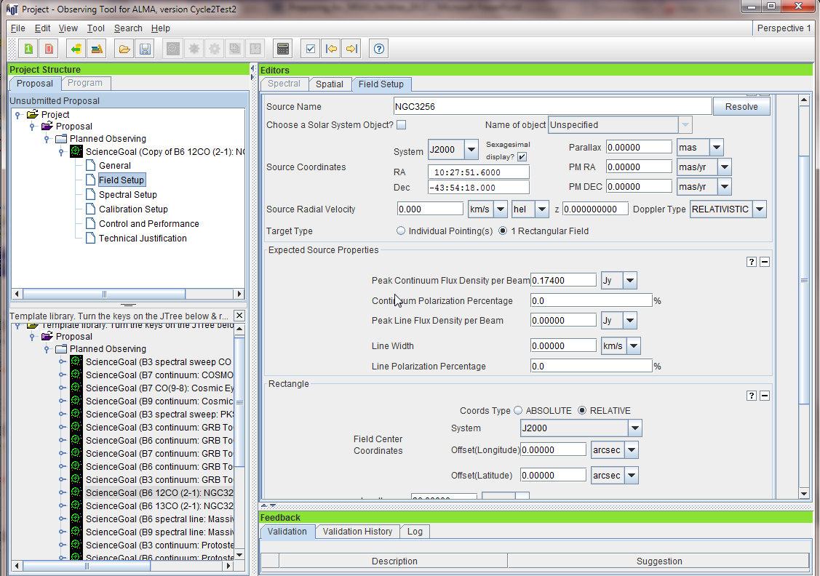
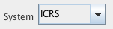
When you resolve a source, check all the returned info, velocity, proper motions may be bogus
New: Cycle 4 OT defaults to ICRS, the standard radio coordinate system
A 10º limitation on source separation in a Science Goal was removed in Cycle 4. The OT groups targets using hierarchical clustering
Cycle3: more than
one field source
can have a mosaic but it’s all with mosaics or none in one SG
Source name, position, proper motion, velocity velocity rest frame
The resulting clusters have a maximum separation between sources of 1º for long baseline configurations and 10º otherwise
Rectangular mosaic or 1/more pointings?
The expected source properties are used with the spectral setup, desired angular resolution, rms, to set the S/N, dynamic range and overall project viability
The resulting clusters and the configurations that will be used to observe them can be examined using the time estimate at the Ctrl & Performance node
Cycle3: Linewidth only given in
velocity units
km/s or m/s

Slide 28
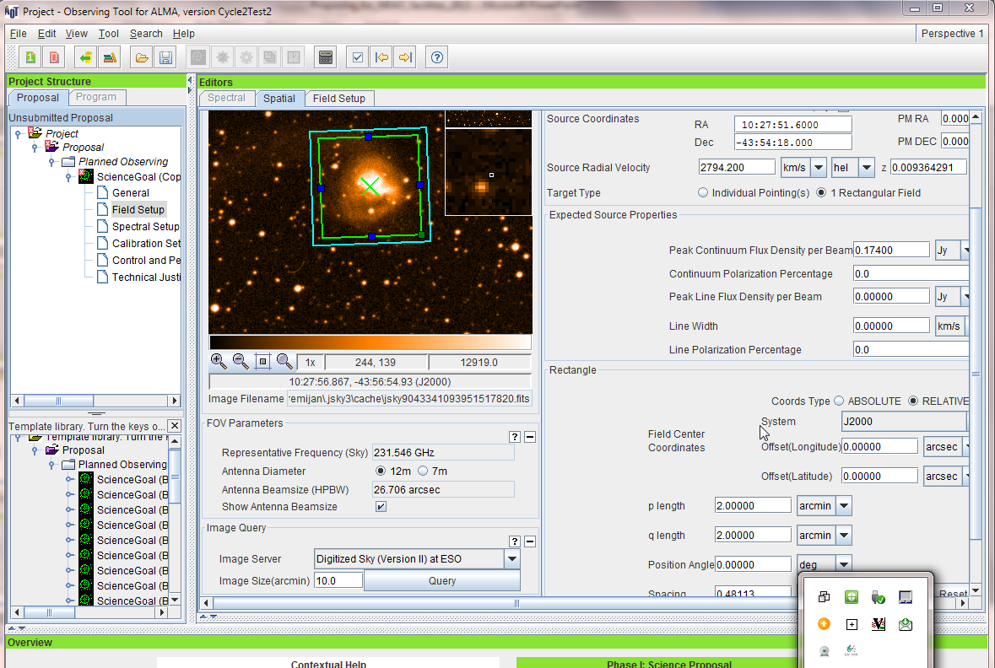
The spatial visualizer
The Spatial tab gives a graphical visualization of the Field Setup.
when you click on this node you will now land on its visualizer tab
Select a background image from an online image server

Slide 29
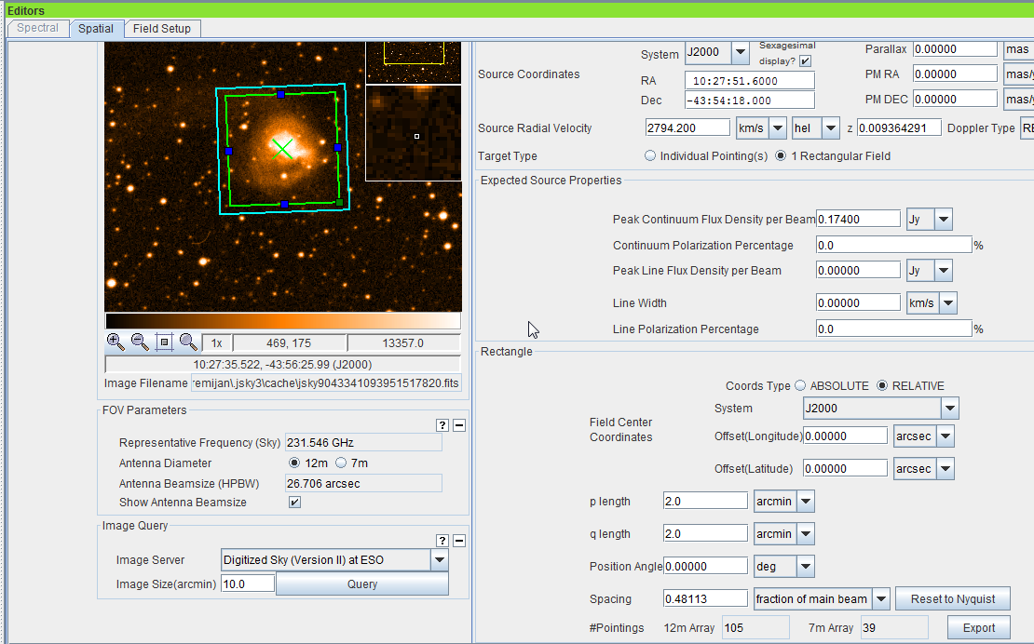
Crafting mosaics
Setting up the mosaic in the Field Setup
Define the length, width and position angle of the region to mosaic. Default is to separate the field centers by about 48% of the primary beam (the Nyquist rate).
HPBWs for 12m antennas are 1.13λ/D
Estimated number of 7m Array pointings
No more than 150 12m Array pointings

Slide 30
Crafting mosaics
Setting up the mosaic in the Field Setup
Define the length, width and position angle of the region to mosaic. Default is to separate the field centers by about 48% of the primary beam (the Nyquist rate).
HPBW for the 12m antennas are 1.13λ/D
Mosaicking is allowed for linear polarization continuum observing in Bands 3-7, both
rectangular and custom - individual pointings overlapping at the beam FWHM
Estimated number of 7m Array pointings
No more than 150 12m Array pointings.

Slide 31
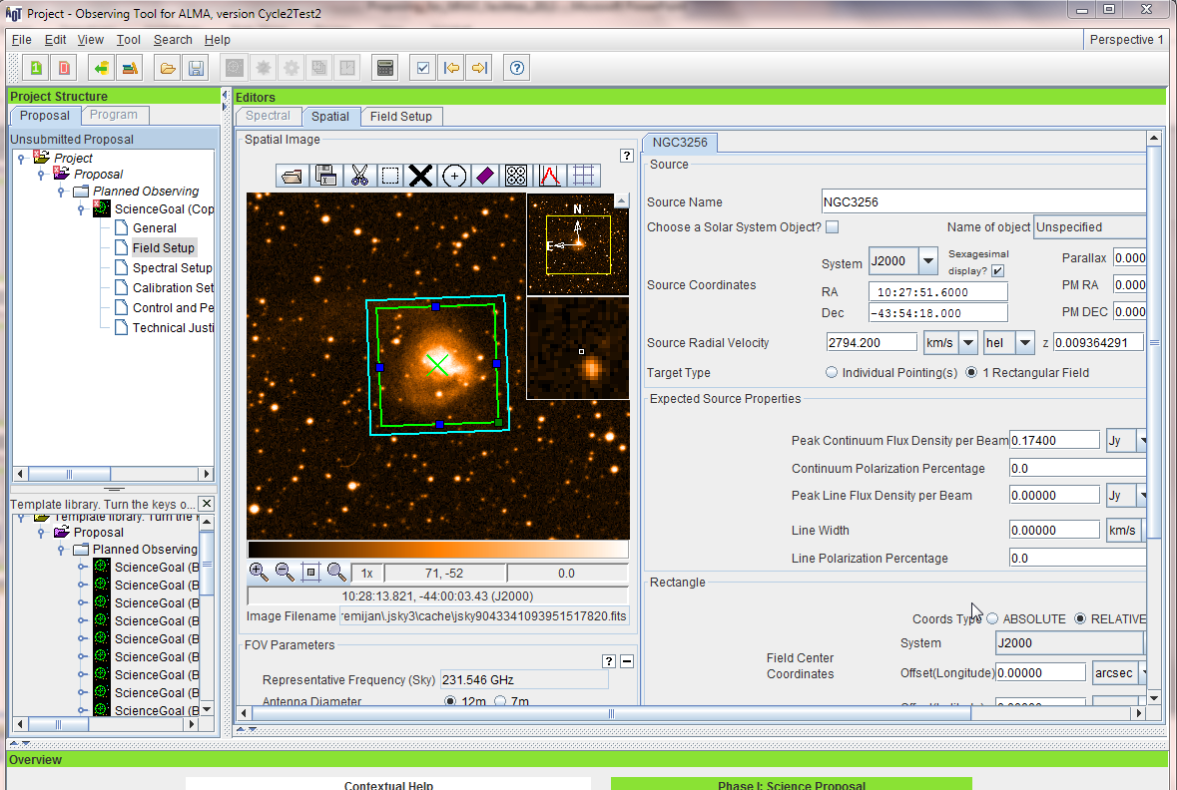
Crafting mosaics
You can load a local fits image
ICRS
You can turn on/off the mosaic beam pattern

Slide 32
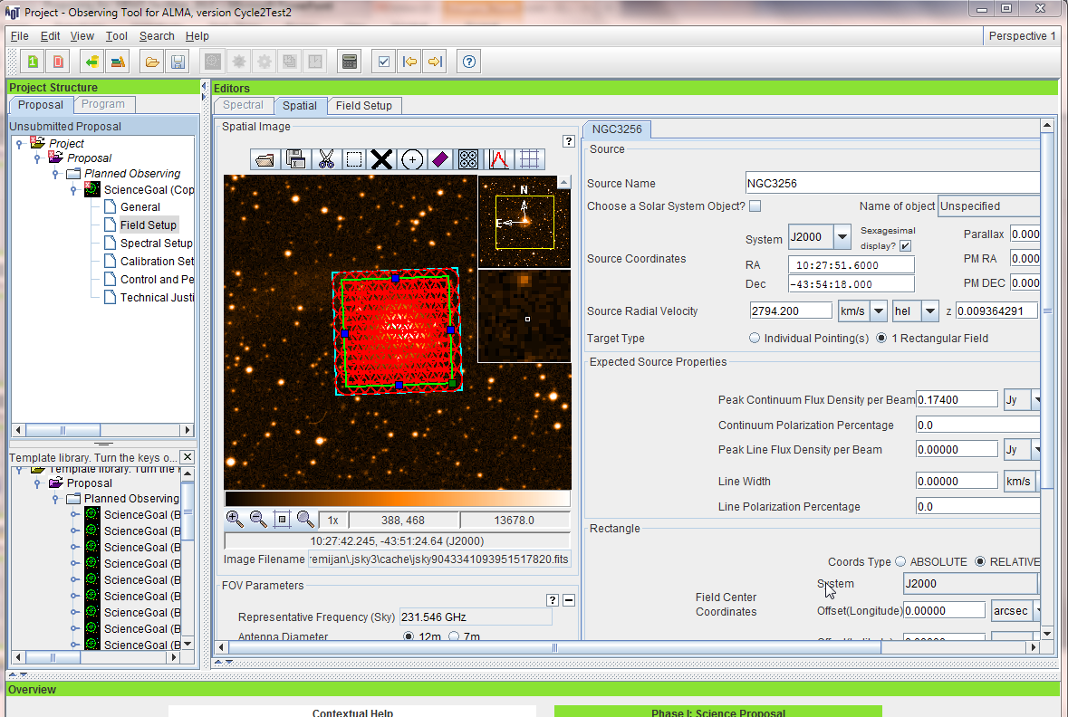
Crafting and displaying mosaics
You can load a local fits image
ICRS
Each circle is the size of the hpbw & the pattern is centered on the pointing center

Slide 33
Crafting and displaying mosaics
You can load a local fits image
ICRS
New! The tiling algorithm now allows an even number of pointings in one row
Each circle is the size of the hpbw & the pattern is centered on the pointing center

Slide 34
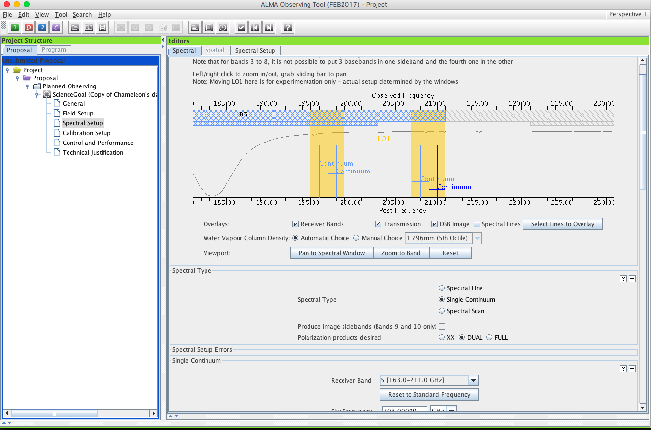
The spectral setup tab
when you click on this node you will land on its visualizer tab
Overlaid lines are saved with the project see below
Bands 9,10 are double sideband but sidebands are correlated separately using 90º Walsh switching.
90º Walsh switching has been on by default since Cycle 7
Band 5 enabled in Cycle 6, overlaps more with Band 4 since Cycle 7

Slide 35
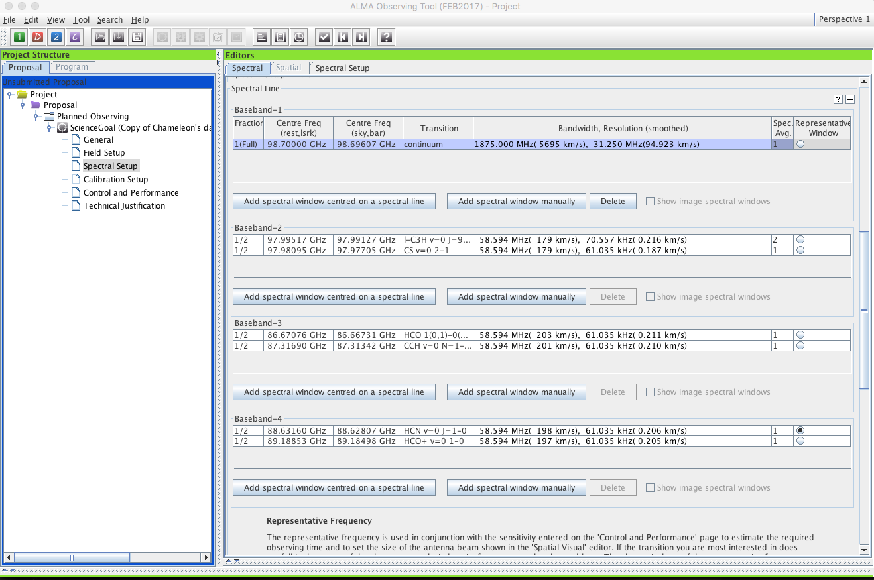
ADD spectral windows to get started!
This option will call up the spectral line picker. Spectral windows added this way retain line id and other info from the Splatalogue
Frequencies may also be entered by hand

Slide 36
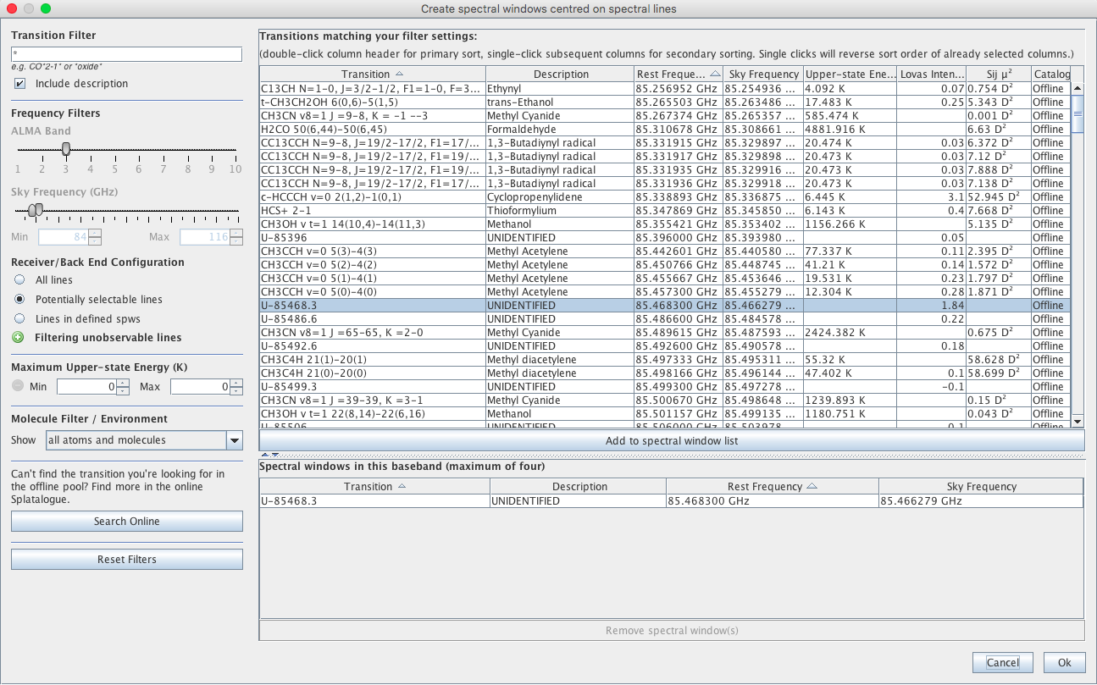
From Cycle 9 -The online Spatalogue is accessible again!
Select one or more lines from a splatalogue-based list you can filter using the tools at left (see below)
Select one or more lines from a splatalogue-based list you can filter using the tools at left (see below)

Slide 37
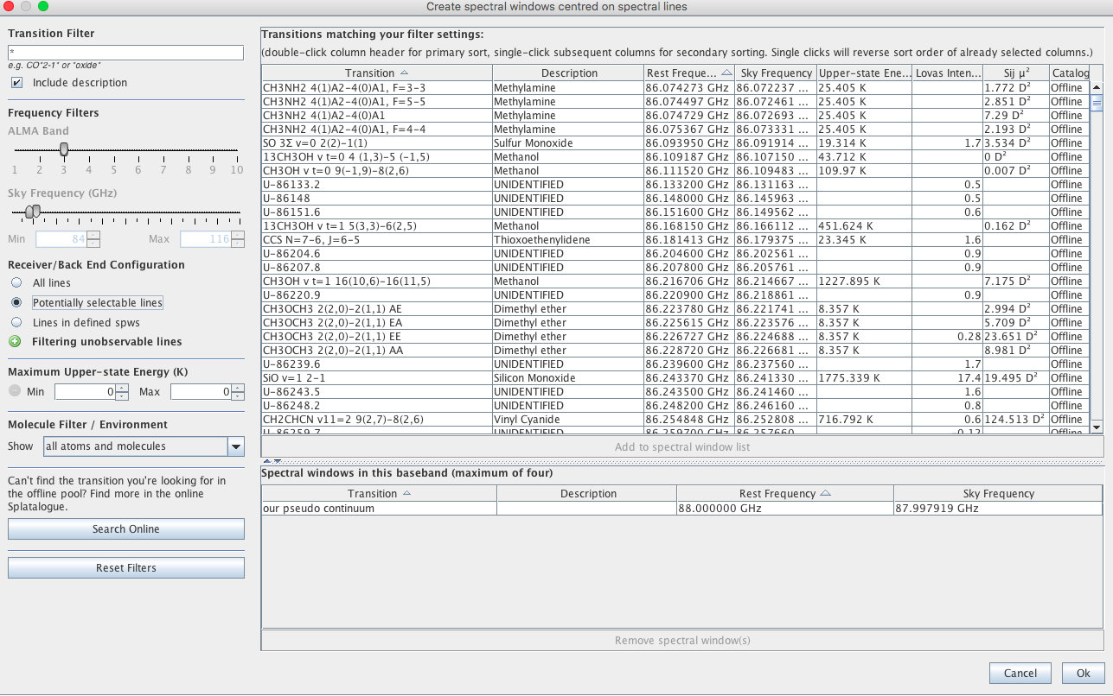
Filter by name
The line lists can be long, so use filters
Filter by receiver band / frequency
The Receiver/Back End Configuration Filters were revised in Cycle 7
Potentially selectable => in either sideband
Before Cycle 7 this used a slider

Slide 38
Sky frequency is shown in barycentric frame so rest and sky frequency differ even when V_{lsrk}=0
Since Cycle 7 the OT wil give validation warnings if any part of a spw is closer than 30 MHz to the baseband edge OR more than half of the spw is within (30 MHz + the line width) of the baseband edge
Default spectral binning is 2 but can be set to other values with justification
Note!
Once a spectral window is defined with a rest frequency within it, the window must always thereafter contain that rest frequency or the OT will complain!

Slide 39
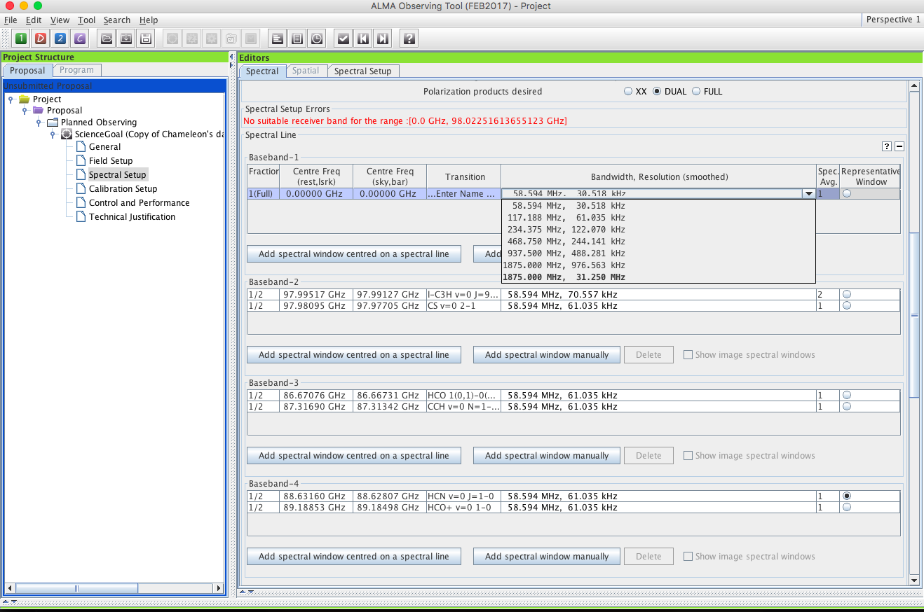
Double click here to select bandwidth & resolution from a dropdown list

Slide 40
Failing to rename a new spw brings a validation error! Picky picky.
Spectral specs share a base- band so the sum of shares can’t exceed 1. Choices for resolution change with this fraction
Notes:
Spectral averaging to 2 barely degrades spectral resolution while reducing data rate by 2, but be careful to maintain adequate spectral sampling and resolution of your lines

Slide 41
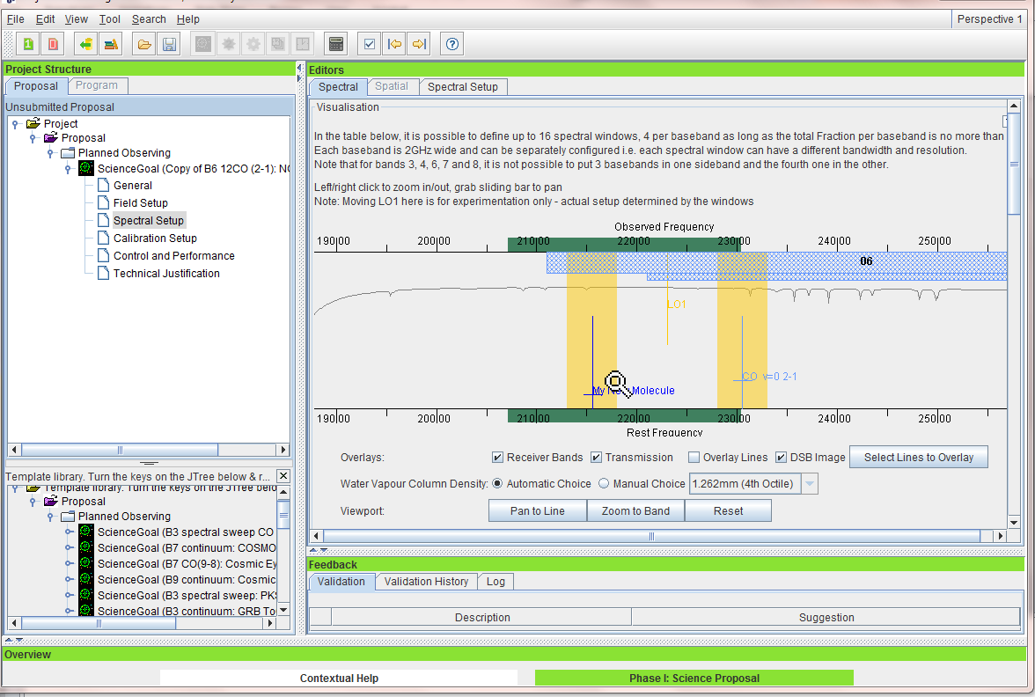
The spectral setup has a visualizer for spectral windows and spectral lines
The spectral tab gives a graphical visualization of the spectral setup. The orange vertical bars are sidebands. This setup is okay!
Drag the yellow vertical to move the first LO
Drag the green slider to slide the VIEW
Click in the yellow area to MAGNIFY
Zoom in here to start

Slide 42
The spectral setup has a visualizer for spectral windows and spectral lines
You can display atmospheric transmission at any octile but the OT will always use the “automatic” choice for the observing time estimate

Slide 43
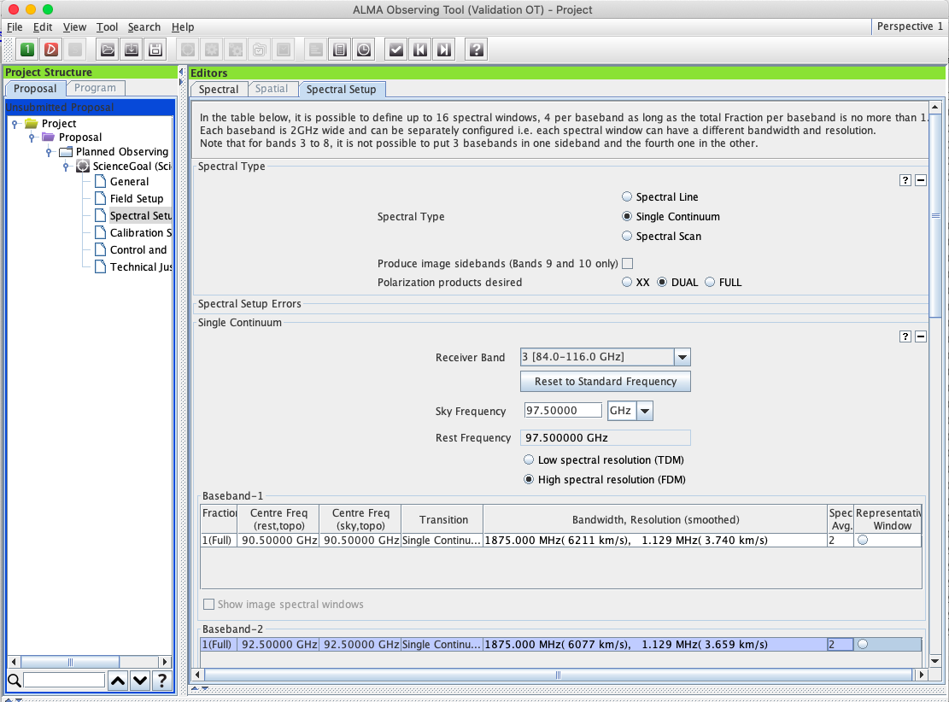
Continuum & new choice of resolution
Standard single continuum setups, can be modified with justification
PI can choose spectral resolution
(Mostly governed by data processing rates, data can be resampled during reduction)

Slide 44
Full Continuum & Polarization
Full Polarization for Bands 3 – 7
If FULL is specified, an expected line or continuum polarization percentage >0 must be given in the field setup
You can edit the frequencies used for continuum polarization.
Standard single continuum setups, can be modified with justification
Full polarization is available for single pointings w/ Standalone ACA

Slide 45
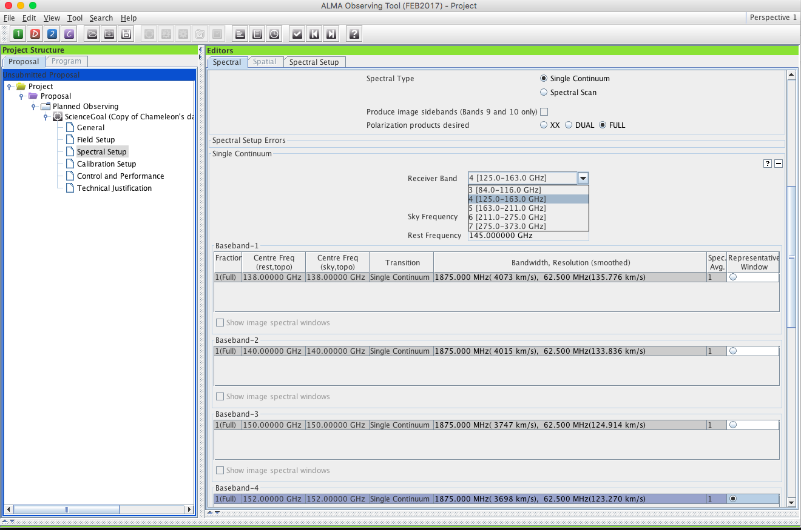
Polarization - suggestion
Full Polarization for Bands 3 - 7
User can edit frequencies used for continuum polarization.
If FULL is specified, an expected polarization percentage must be given with the field setup tab
Standard single continuum setups, can be modified with justification
Suggestion:
Polarization Schedule blocks are 3+ hours long to get parallactic angle coverage and the rms noise may be much less than specified on the ctrl&perf page
TECHNICAL JUSTIFICATION shows the actual expected rms noise and various S/N ratios

Slide 46
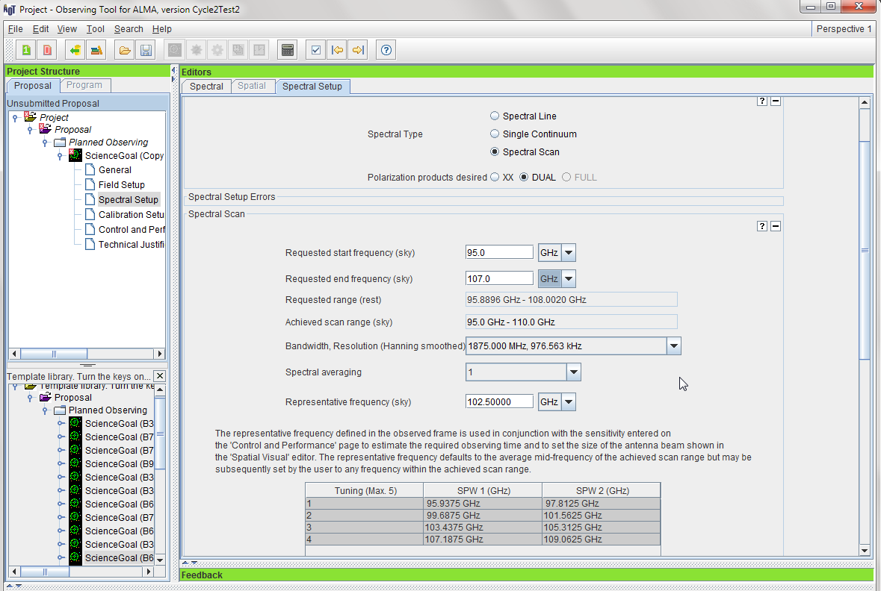
Automated spectral scan - I
Total Power spectral scans may appear in Cycle 10
Jam tomorrow, never jam today
Spectral scans may be used with 7m observing including standalone 7-m
Automated Spectral Scan mode and tunings
Spectral scan observing was made more efficient in Cycle 7 by joining all calibrator tunings to lessen the number of antenna pointing calibrations

Slide 47
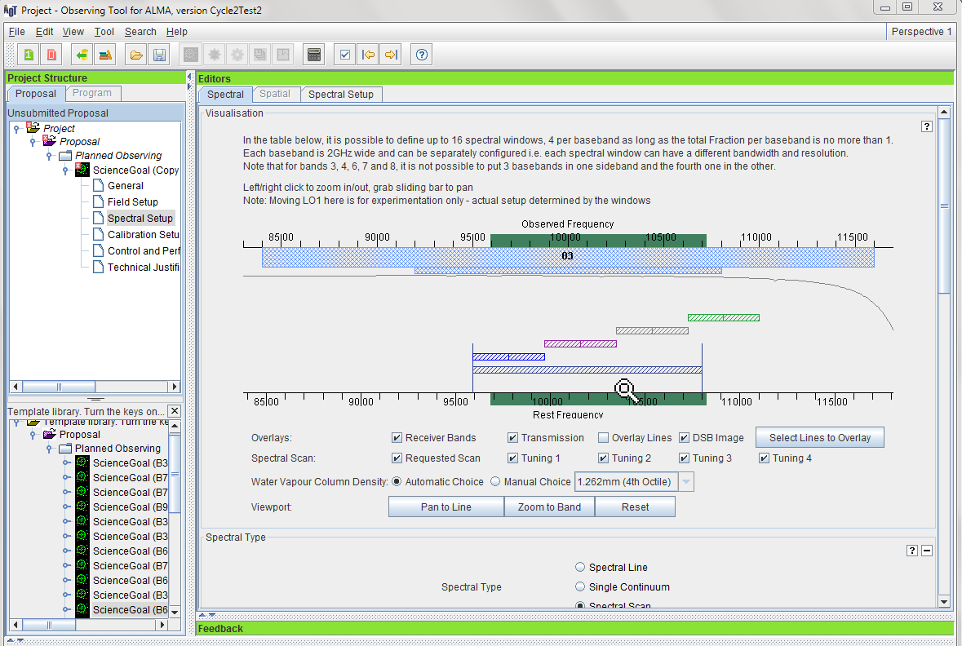
Automated spectral scan - II
Visual Representation of the Spectral Scan Mode – Actual spectral coverage vs. requested coverage

Slide 48
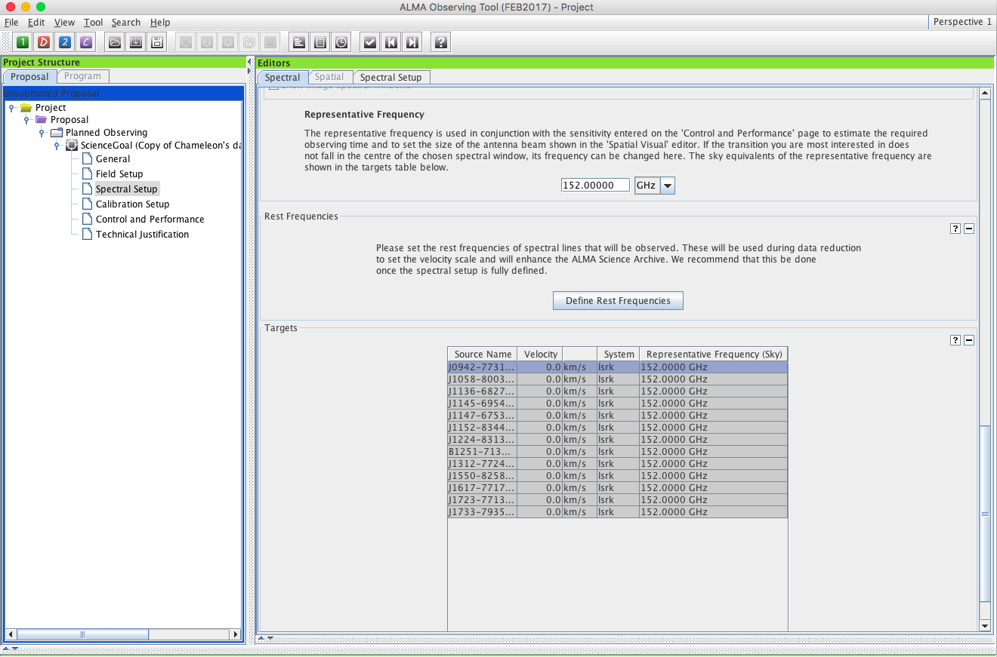
Saving spw & line rest frequencies
This calls a version of the spectral line picker to add rest frequencies that you may wish to note. This can be used later in data reduction to set velocity scales for lines that fall within a spectral window
Visual Representation of the Spectral Scan Mode – Actual spectral coverage vs. requested coverage
List of saved rest frequencies including
-spw centers
Saved overlaid lines (if desired)
Defined rest frequencies

Slide 49
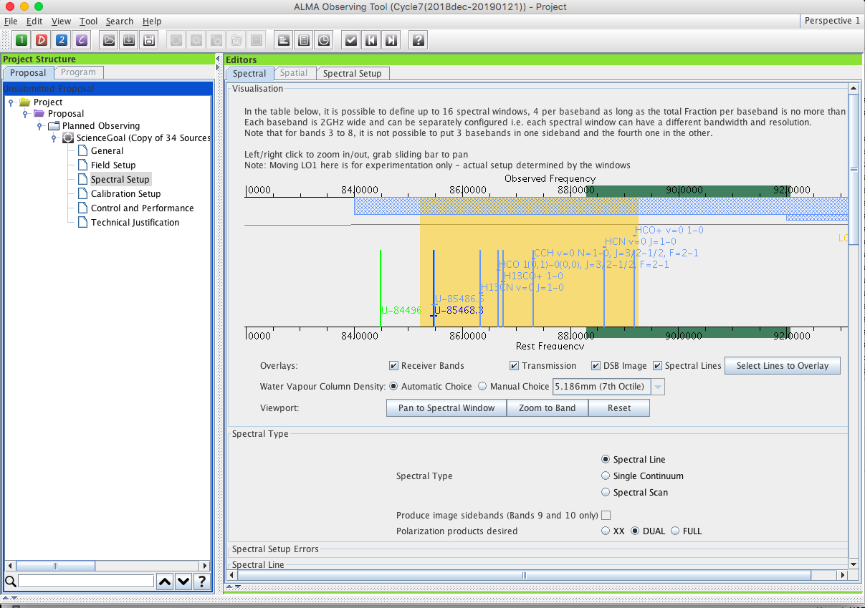
Viewing spw & line rest frequencies
All the spw centers, saved overlaid lines and defined rest frequencies will be visualized even if they can’t or won’t be observed

Slide 50
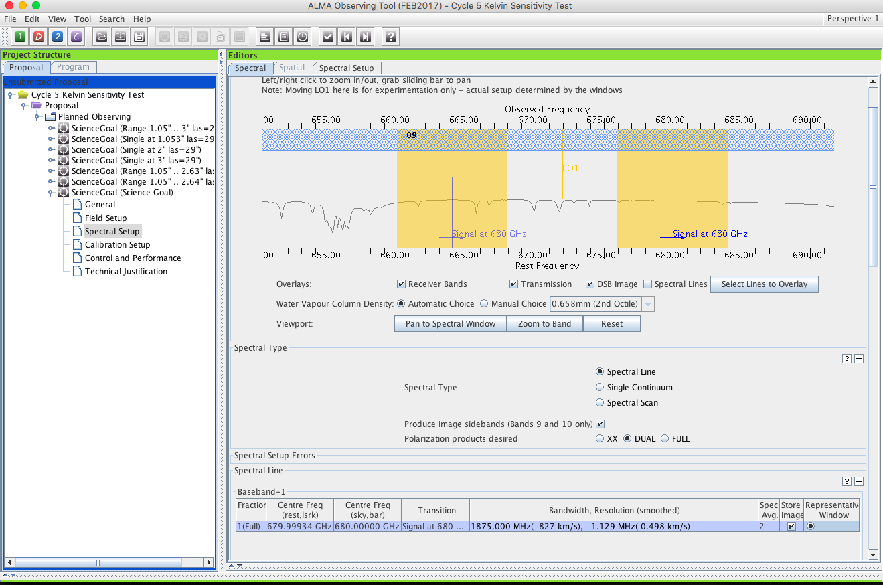
Bands 9&10 - sideband separation (90º Walsh)
Only 1.875 GHz bandwidth, line or continuum
Bands 9 & 10 have double sideband receivers but the sidebands can be separated using an additional phase-switching step, 90º Walsh switching. This can be turned on solely to reject lines in the image sideband, but once enabled, the two SB may be stored separately. Note that the noise level is not affected because only a correlated signal can be separated
See where lines in one sideband appear in other if checked
On by default since Cycle 7
Record both sidebands?
Only 1.875 GHz bandwidth, line or continuum allowed

Slide 51
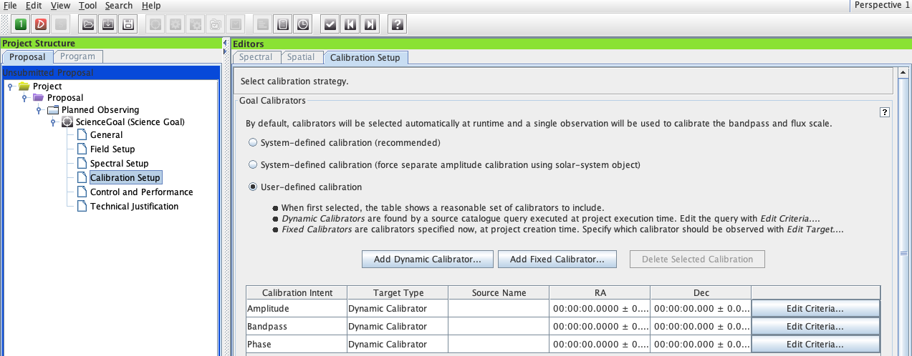
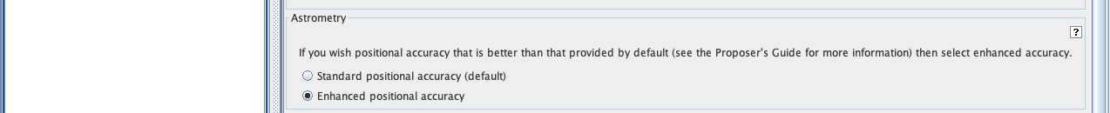
Enhanced positional accuracy - 1st step to astrometry
At the bottom of the Calibration Setup page an “astrometry” option
Uses extra calibration and a bright grid calibrator must be within 5º

Slide 52
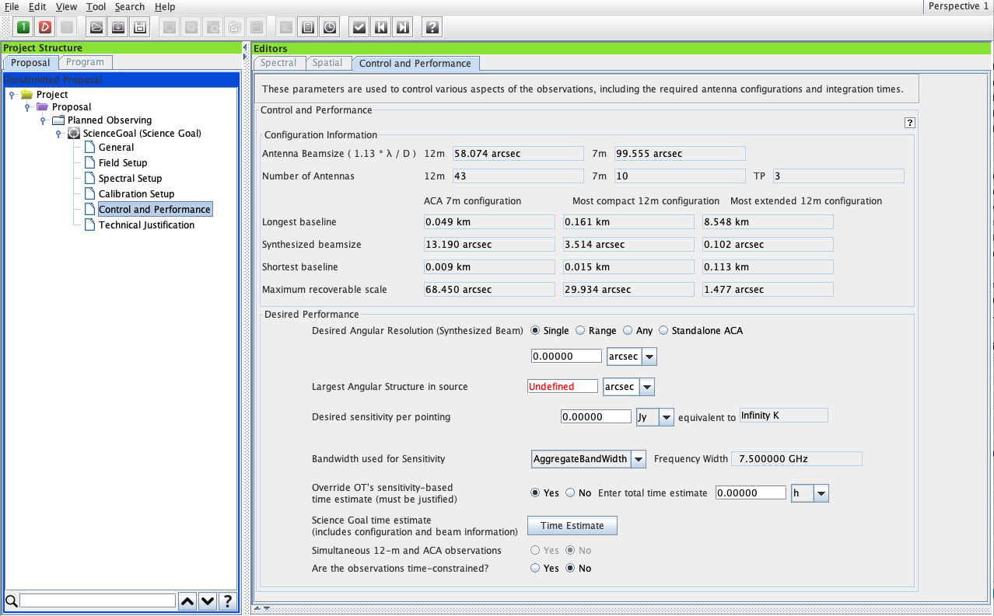
The Control and Performance Page
Control and Performance defines the required angular resolution, sensitivity, largest angular scale, etc.
Short max baseiines in Cy8
Array properties summarized
New look, better description, same great function

Slide 53
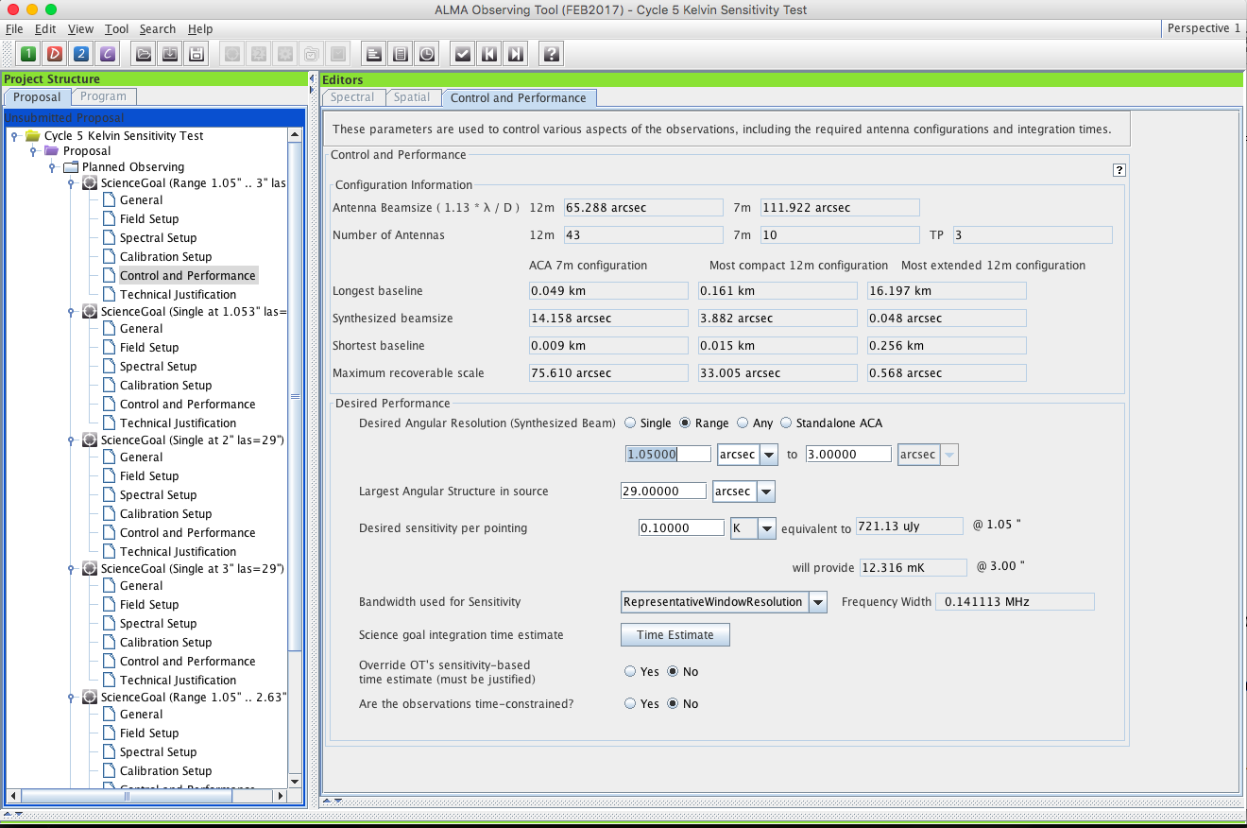
The Control and Performance Page
Control and Performance shows what resolution and angular scales are observable and defines required angular resolution, sensitivity, largest angular scale, etc
Specify the desired rms Jy/beam noise level and the bandwidth over which that should be measured
For spectral line the bandwidth for sensitivity must not be less than the channel spacing in the representative spectral window

Slide 54
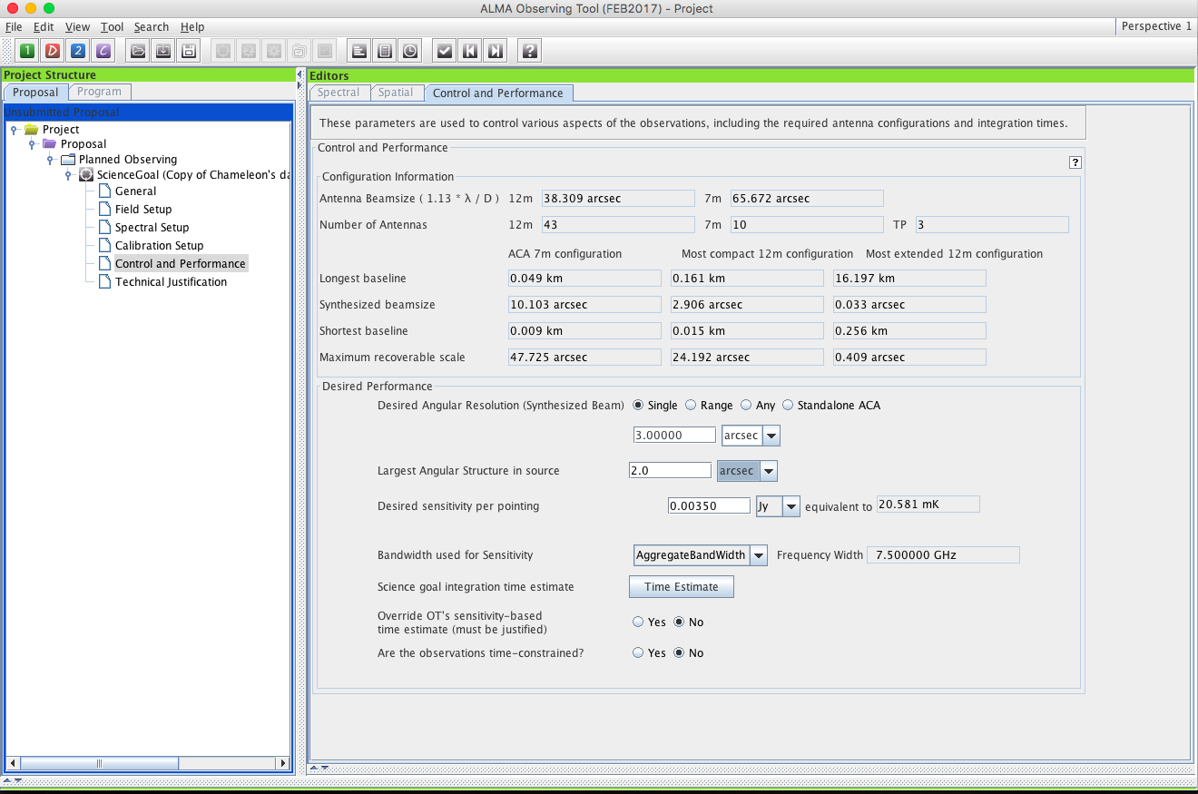
Angular resolution options control which configurations and combinations of arrays are considered. Here a single resolution is entered and it will be considered to have a +/-10% margin
Flux - Temperature conversion at the desired resolution

Slide 55
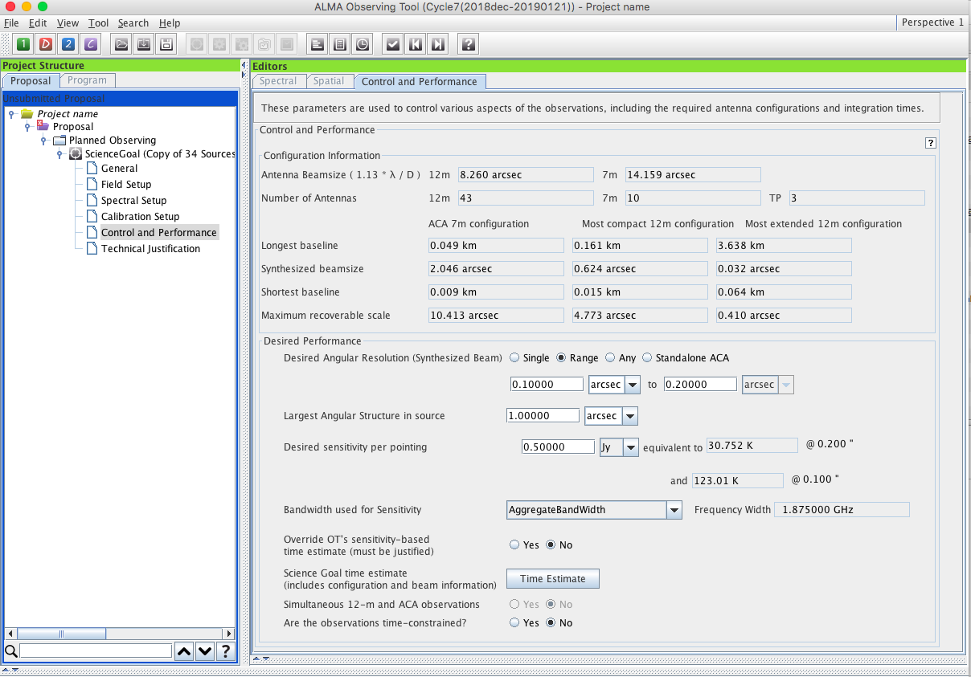
RANGE:
You can specify an acceptable range of angular resolution for the 12m array. This implies a set of configuration possibilities, use the planning & time estimate to see what they are
Since Cycle 6 the min and max allowed user-input angular resolutions are ½ the smallest and twice the largest of the values shown for the 12m configurations
Notes:
.

Slide 56

With “ANY” there is no largest angular scale (0 by definition) or angular resolution and the project is supposed to be suited to any non-LB configuration
The “ANY” option replaced older ways of specifying a point source but is more general

Slide 57
ANY may not be the best choice even if you really don’t care.
Using very compact arrays for very northerly sources increases times from shadowing
The most extended configurations place stronger demands on phase calibration

Slide 58

Bands 9-10 can be used with Standalone ACA
Full polarization for single pointings w/ Standalone ACA
With Standalone ACA there is a variable largest angular scale but angular resolution is fixed by the observing frequency in the representative spectral window

Slide 59

Use the planning&time estimate popup to see how your sources will be observed, how they may have been clustered and how the time is being used. When many combinations of configurations are shown, the 1st choice minimizes 12m time
The time estimate popup shows how the OT has grouped targets into clusters and what combinations of synthesis + TP will be used to observe them
The beam ellipticity is shown with the maximum axial ratio that will be allowed during scheduling
This also shows how your time is distributed among the various things that happen
Use “planning&time estimate” to see what combinations are possible, what was chosen
Notes:
.

Slide 60

SG Planning and Time Estimates
scroll down in the planning popup to see a breakdown of how the required time is comprised by its various constituents
This project needs 12m + 7m synthesis owing to the combination of angular resolution and largest angular scale

Slide 61
Single source time estimates
Note that the OT calculates the number of executions based on an estimate of the maximum duration of an SB. This means that adding a little bit of on-source or calibration time can cause a significantly larger total time if another execution is implied

Slide 62


Use Tool->display project time summary on the main menu to see these summaries per science goal

Slide 63


Especially when using a RANGE of angular resolution:
Rules are operating under the hood to choose among the possible configuration choices and they may be biased toward the low resolution end of an angular range because less 12m time is needed. Variations in the range can cause disproportionately large differences in the time.
In the cases above only the upper end of a range changes, from 1” to 3”
Be careful that the OT is not making choices for you that you would not make for yourself. Before submitting with a range, narrow it and use the project time summary to examine the choices the OT is making
Notes:
.

Slide 64

Time constrained observing
A file format is defined in the help to allow importing a list of time constraints
v
Entering time-constrained observations –> Dates, Epochs or Monitoring
With appropriate justification or additional information

Slide 65


The sensitivity calculator is available separately in the OT (or on the web)
Using this tool or options in the spectral visualizer’s opacity display will not affect the OT’s observing time calculation

Slide 66

Technical Justification
Here would be the standard required justification of the sensitivity parameters
There are separate standard sections for Sensitivity, Imaging and Correlator and another may appear to allow you to justify some of the parameter choices you may have made
Each requires its own 50+ word justification
Each standard section comes with a summary of the requested input information to detail the different technical aspects of your program.

Slide 67

Technical Justification
Here would be the standard required justification of the imaging parameters
Exceptions to standard practice require separate justification. Here, the OT notes that the ACA is selected even though the OT thinks it is unneeded.
Here would be the regular required correlator justification

Slide 68


When the time is ripe … validate & submit
Note the spiffy new icons!
Click in either place to check that your project will validate in the OT. If it doesn’t validate when you submit, the archive will reject it.

Slide 69

When the time is ripe … validate & submit
Note the spiffy new icons!
Click in either place to make sure that your project will be validated by the OT. If it doesn’t validate when you submit, the archive will reject it.
NEW! The OT lets you know when it’s validating.

Slide 70

Clicking on a validation error should take you to the problem directly

Slide 71

When the time is ripe … validate & submit
When you are satisfied that your proposal is complete, use the top level File menu to submit it to the archive

Slide 72
When the time is ripe … validate & submit
Or use the upload icon below the main menu
When you are satisfied that your proposal is complete, use the top level File menu to submit it to the archive

Slide 73


Recap

Slide 74





Use preferences to customize

Slide 75
A Few OT Tips…
The same cut and paste commands you use outside the OT for text also work inside it since Cycle 5
Ctrl-Z global shortcut will expand out all succeeding items in the J-tree (try it, you’ll see what we mean)
Holding down ALT when making choices in dropdown lists will convert to the unit or type of the new choice
Otherwise, only the description changes, not value
OT does galactic-celestial conversion automatically
Cannot convert in other ways, eg not FK5 J2000 to ICRS. FK5 J2000 is deprecated

Slide 76
A Few More OT Tips…
In the J-tree: Holding down the alt key in combination with the up/down arrows will move from a node in one SG to the same node in the adjacent SG (try it when you have more than one SG)
Ctrl-B will generate all SB’s for items lower in tree

Slide 77


Don’t be afraid to ask for directions
Suggestion: input file formats are shown in the help sections that you invoke with a local “?” button but writing to a file provides an example most directly

Slide 78

The motherships are always there
www.almascience.org
www.almascience.nrao
Notes:
User support is a priority – answer helpdesks within 48 hours

Slide 79


Have no fear, ALMA Helpdesk is here…
ALMA

Slide 80


For more info:
https://almascience.nrao.edu/
The Atacama Large Millimeter/submillimeter Array (ALMA), an international astronomy facility, is a partnership of Europe, North America and East Asia in cooperation with the Republic of Chile. ALMA is funded in Europe by the European Organization for Astronomical Research in the Southern Hemisphere (ESO), in North America by the U.S. National Science Foundation (NSF) in cooperation with the National Research Council of Canada (NRC) and the National Science Council of Taiwan (NSC), and in East Asia by the National Institutes of Natural Sciences (NINS) of Japan in cooperation with the Academia Sinica (AS) in Taiwan. ALMA construction and operations are led on behalf of Europe by ESO, on behalf of North America by the National Radio Astronomy Observatory (NRAO), which is managed by Associated Universities, Inc. (AUI), and on behalf of East Asia by the National Astronomical Observatory of Japan (NAOJ). The Joint ALMA Observatory (JAO) provides the unified leadership and management of the construction and operation of ALMA.

